Slide 1
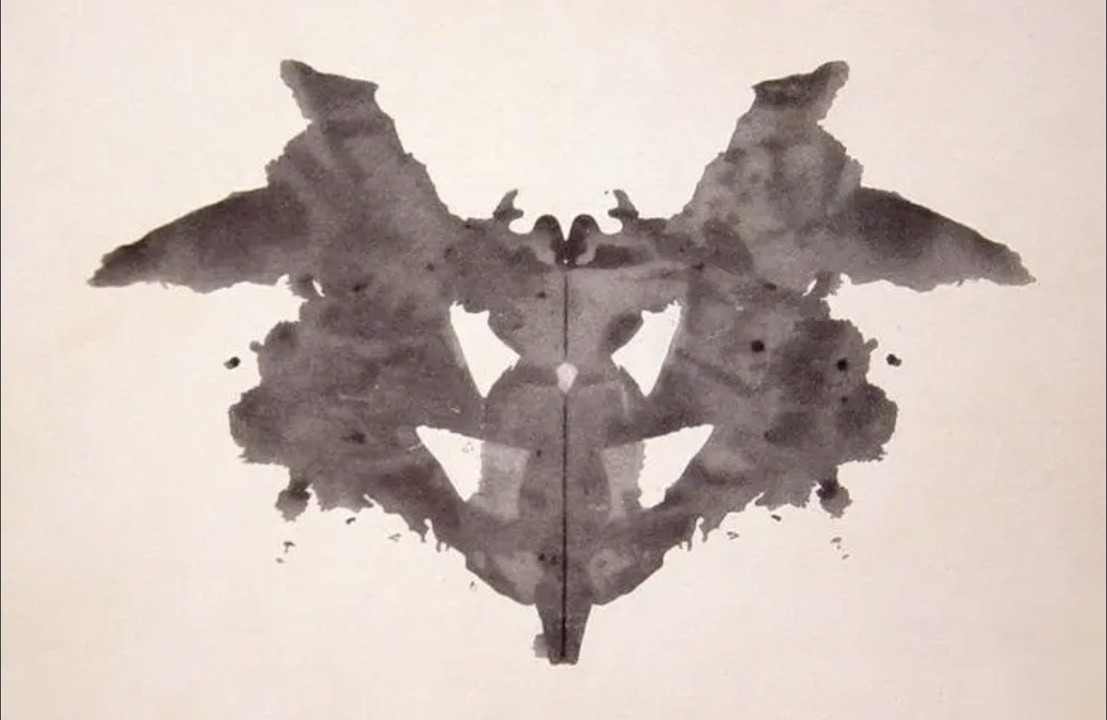
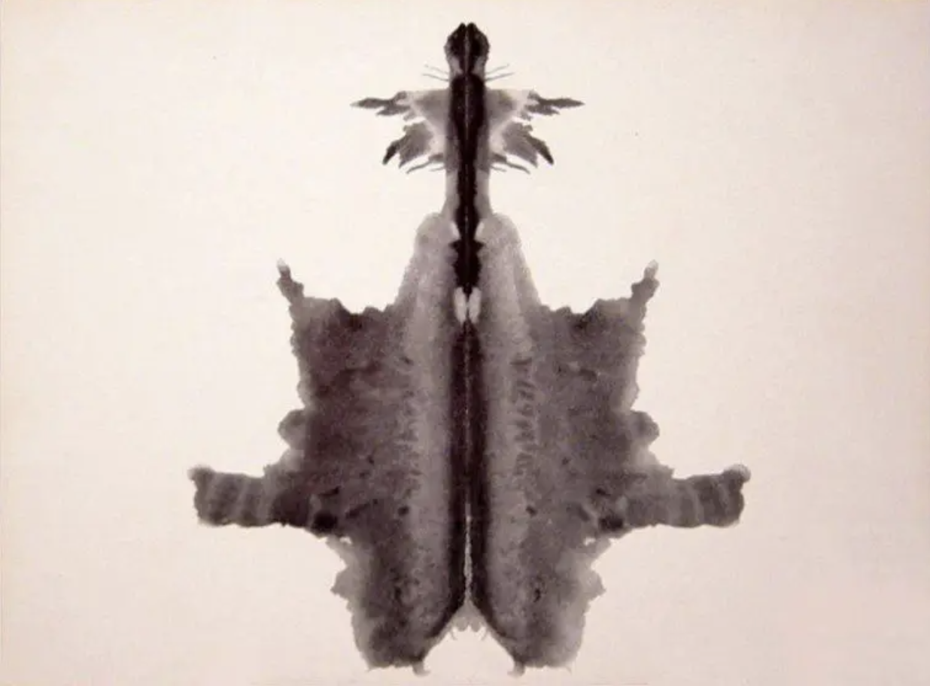
Rorschach Inkblots: AI Pareidolia
Exploring Artificial Perception
Tanner Rohloff, Axel Reich

Slide 2
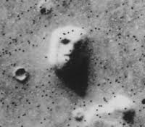
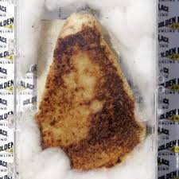
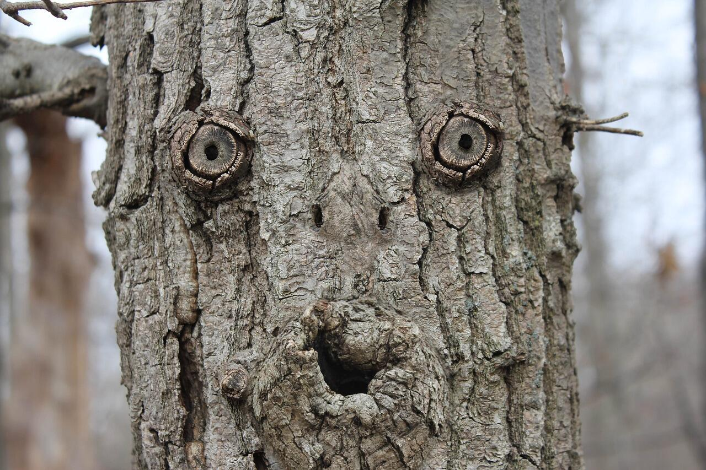
Pareidolia
The psychological phenomenon where the mind perceives a familiar pattern of something where none actually exists like seeing a face in a cloud or an animal in an inkblot.
Can cause people to see faces in things that aren’t faces, such as in a tree or on a fish.
Famous examples include the face on mars, or the image of the virgin mary on the grilled cheese.
Face on Mars
Virgin Mary Grilled Cheese
Face on Tree

Slide 3

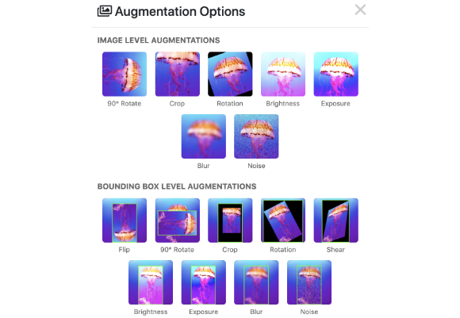
The Data: Animals-10
•
26,000 Images: A robust dataset split into 10 distinct classes (Dog, Cat, Spider, Butterfly, etc.).
•
Standardization: All images resized to 224x224 pixels and normalized (0-1 pixel values).
•
Data Augmentation: To prevent overfitting, the pipeline artificially expands the dataset by rotating, zooming, and flipping images during training.

Slide 4






The Methodology
Train
Test
Visualize
We built two distinct "brains": A naive model built from scratch, and an expert model using Transfer Learning (MobileNetV2), both trained on the Animals-10 dataset.
We subjected both models to the standard Rorschach Inkblot Test, forcing them to classify the abstract images into one of 10 animal categories.
Using Grad-CAM (Gradient-weighted Class Activation Mapping), we visualized exactly which pixels activated the neural network's decision.

Slide 5
The Method
1. Data Collection (data_pipeline.py)
Source: We downloaded the "Animals-10" dataset from Kaggle, consisting of ~26,000 images across 10 animal classes (dog, cat, butterfly, etc.).
Preprocessing: We built a pipeline to resize all images to a uniform 224x224 pixels and normalized their pixel values (0-255) to a 0-1 range for faster model convergence.
Augmentation: We applied real-time data augmentation (rotation, zoom, flips) to the training set to artificially expand the dataset and prevent the models from memorizing specific images.
2. Model Architectures
Model A: The Naive Student (model_scratch.py)
Design: We built a Convolutional Neural Network (CNN) from scratch using three blocks of Conv2D and MaxPooling layers.
Purpose: This model started with randomized weights, meaning it had zero prior knowledge of the visual world.
Capacity: It is relatively shallow to represent a "naive" visual system with limited processing power.
Model B: The Expert (model_transfer.py)
Design: We utilized MobileNetV2 as a base, a model pre-trained by Google on the massive ImageNet dataset (1.4 million images).
Transfer Learning: We froze the pre-trained "base" (the feature extractor) and added a custom classification "head" to learn our specific 10 animals.
Fine-Tuning: We unfroze the top layers of the base model and re-trained them with a tiny learning rate, allowing the expert features to adapt specifically to our animal classes.

Slide 6
The Method
3. Training Process (train.py)
Dual Training Loop: We created a single script to train both models sequentially on the exact same data splits to ensure a fair comparison.
Model A Training: We trained the scratch model for 15 epochs, achieving a validation accuracy of ~62%, indicating it learned basic patterns but struggled with complexity.
Model B Training: We trained the transfer model in two phases (Head Training + Fine-Tuning), achieving a validation accuracy of ~96%, demonstrating superior visual understanding.
4. Comparison & Analysis (predict_and_visualize.py)
The Rorschach Test: We fed both trained models 10 standard Rorschach inkblot images (which they had never seen before) and recorded their top class predictions.
Grad-CAM Visualization: We used Gradient-weighted Class Activation Mapping to generate heatmaps, revealing exactly which pixels the models focused on to make their decisions.
Results: We compared the AI predictions to human norms (Exner system) and found that the "Expert" model saw complex shapes (like a Spider on Card 4), while the "Naive" model showed a strong bias toward simple symmetry (predicting "Butterfly" for most cards).

Slide 7
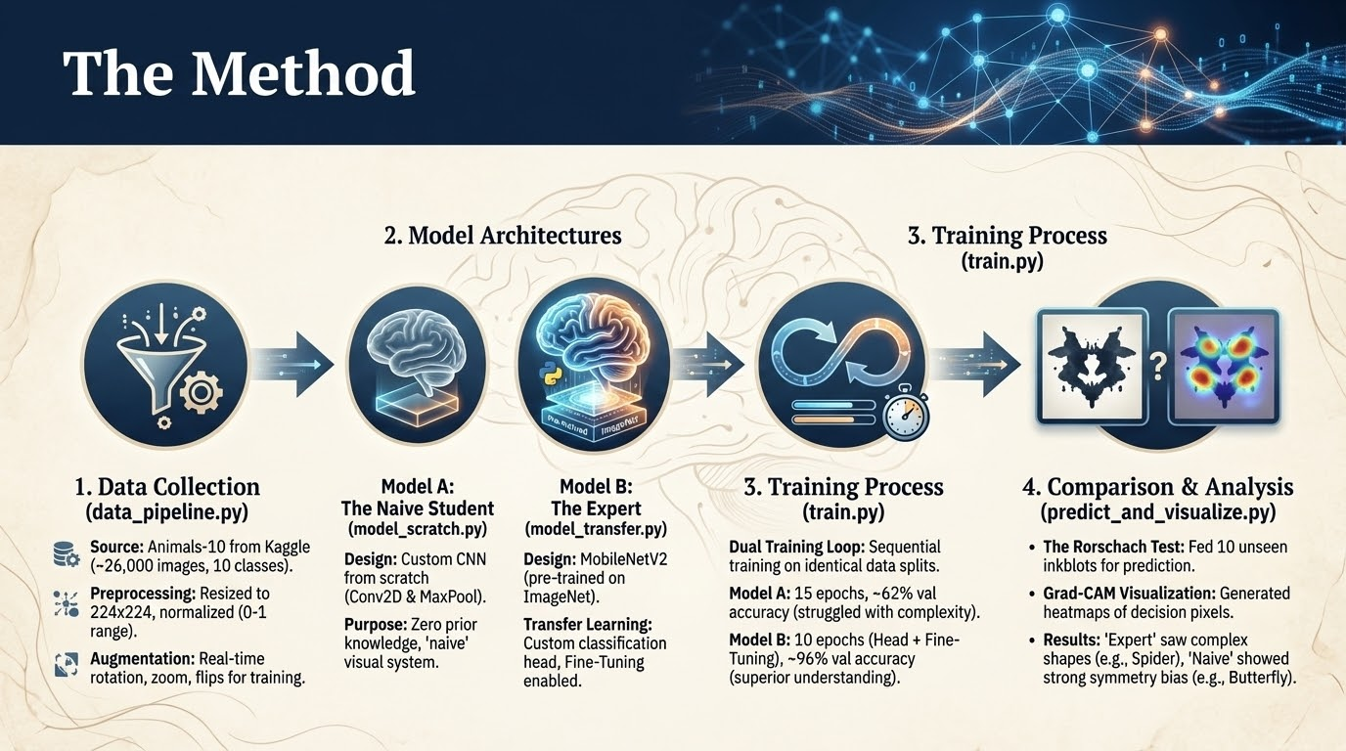

Slide 8
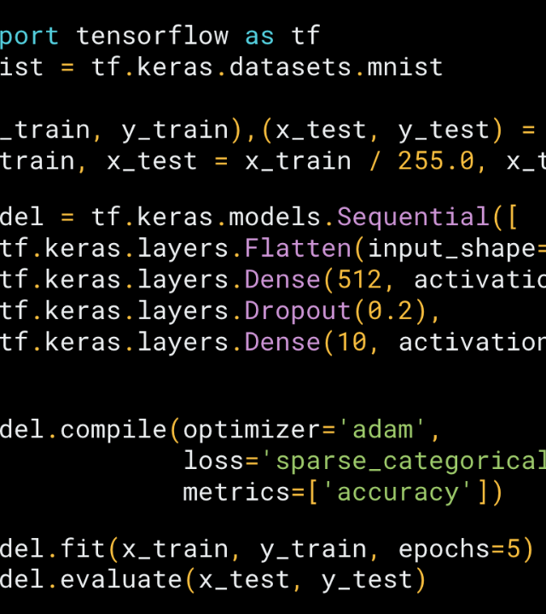
Model A: The Naive Student
Architecture: Custom CNN
Built from scratch using basic Convolutional layers (Conv2D) and Max Pooling from tensorflow.
The Child
This model represents a brain with limited "life experience." It has only ever seen the training data and starts with zero prior knowledge. It struggles to learn complex features without massive amounts of data.

Slide 9
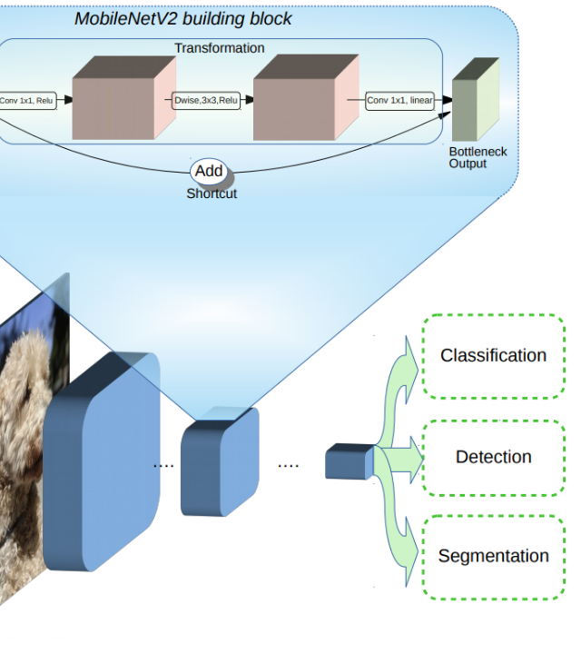
Model B: The Expert
Architecture: MobileNetV2
Leveraging Transfer Learning, we used a model pre-trained by Google on 1.4 million images (ImageNet).
The Adult
This model represents an "adult" brain. It already understands edges, textures, and shapes before it even sees our animals. We "fine-tuned" it to specialize in our specific task.

Slide 10
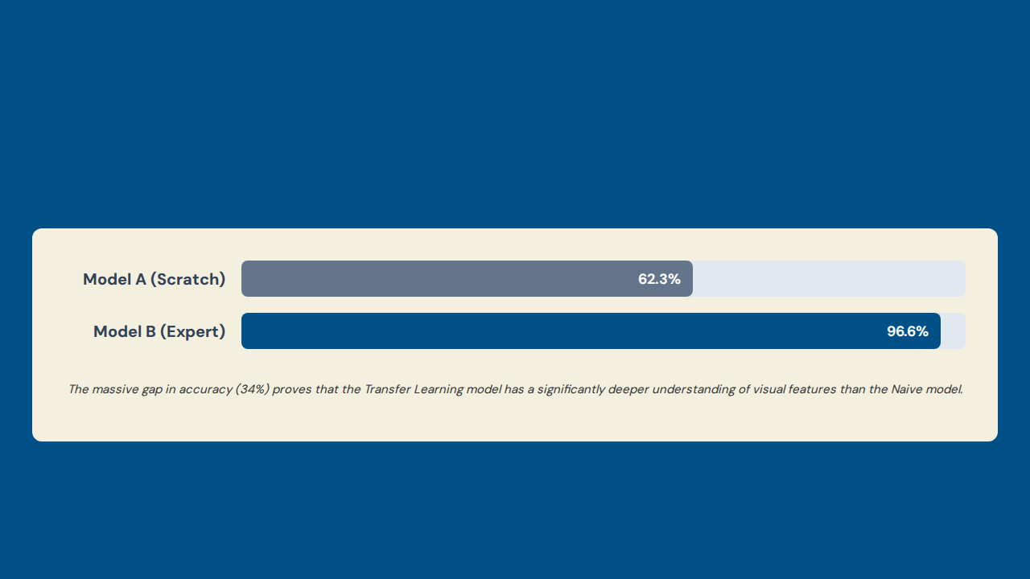
Validation Accuracy
15 epochs
10 epochs

Slide 11

Visualizing the Brain
What is Grad-CAM?
Why use it?
Grad-CAM (Gradient-weighted Class Activation Mapping) is a visualization method that shows which regions of an image most strongly influenced a neural network’s prediction.
It works by measuring how important each pixel (or region) was for the specific class the model predicted.
It produces a heatmap overlaid on the original image: red = high influence, blue = low influence.
It’s like showing where the model “looked” when deciding what the image contains.
Grad-CAM helps us understand what the model is thinking. Specifically:
Interpretability – It tells you why the model made its prediction.
Verification – You can check whether the model is using meaningful shapes or just focusing on background noise.
Bias Detection – A heatmap can reveal if the model cheated (e.g., always focusing on symmetrical features → “butterfly bias”).

Slide 12
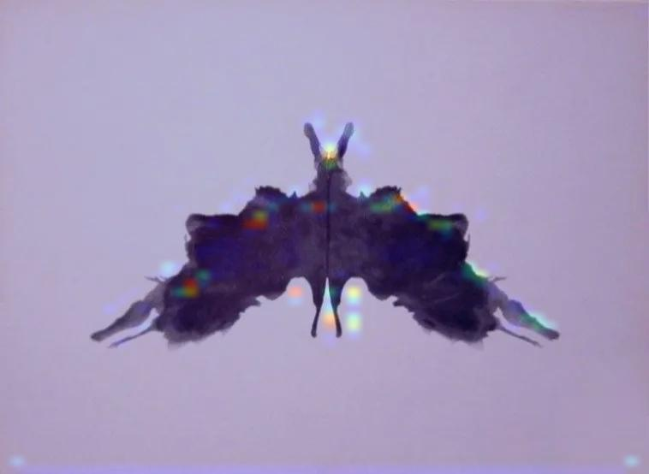
Result: The "Butterfly Bias"
The Naive Model's Confusion
Model A guessed "Butterfly" for 6 out of the 10 cards, often with low confidence (~40-50%).
Analysis: Without deep feature recognition, the model likely defaulted to "Butterfly" simply because the Rorschach blots are symmetrical, a primary feature of butterflies. It didn't "see" the ink; it just recognized the symmetry.

Slide 13
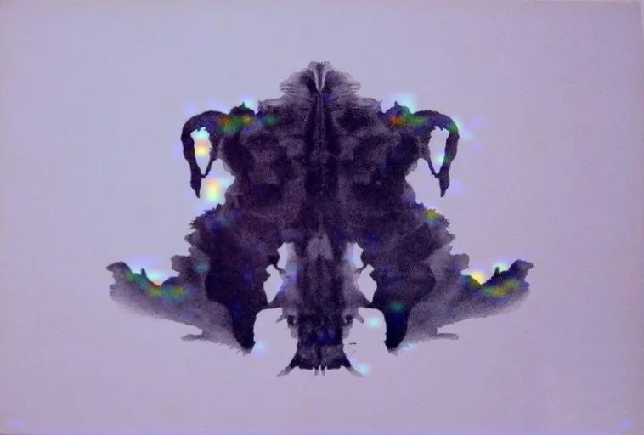
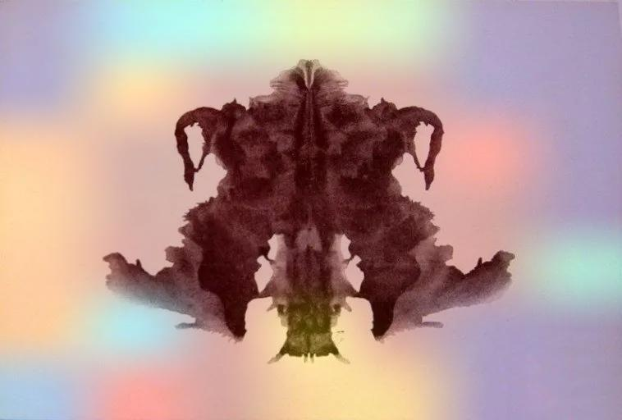
Result: The "Spider" Finding
The Expert Model's Perception
On Card 4 (often called the "Suicidal Giant"), Model B identified a "Spider" (56%).
Model A
Model B interpreted the heavy dark mass as resembling the features of a spider such as a central body and multiple radiating shapes. While the image is not actually a spider, the model’s prior experience makes this the closest learned match.
Model B

Slide 14
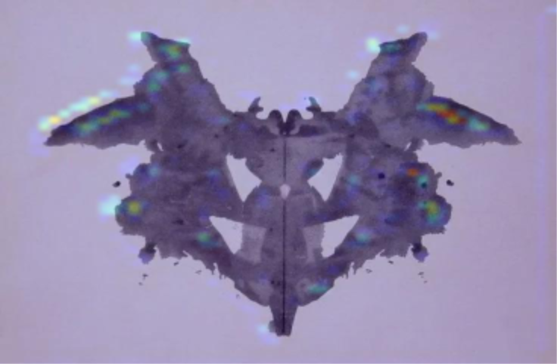
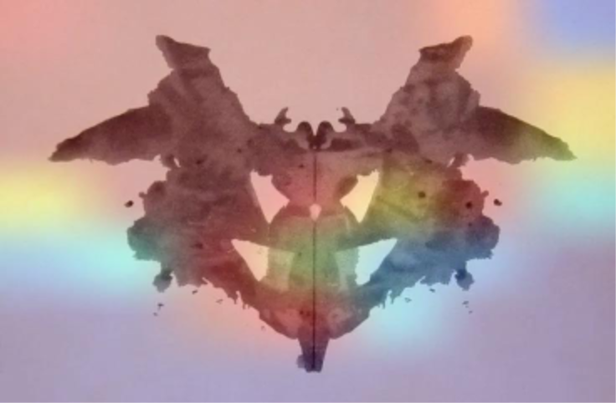
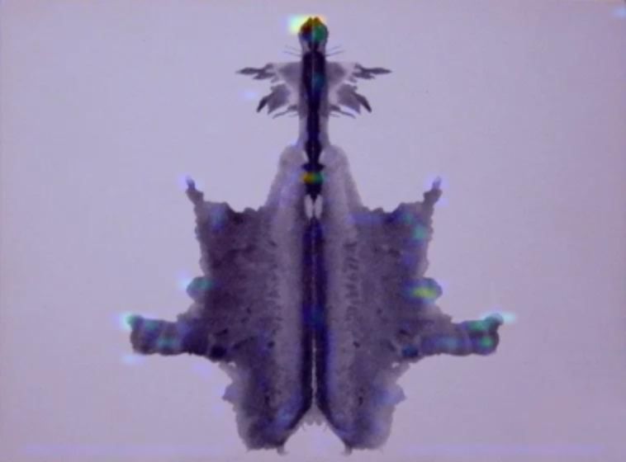
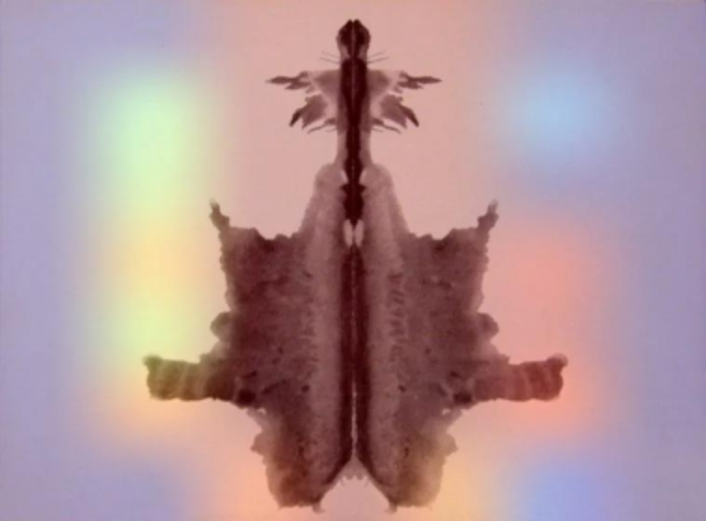
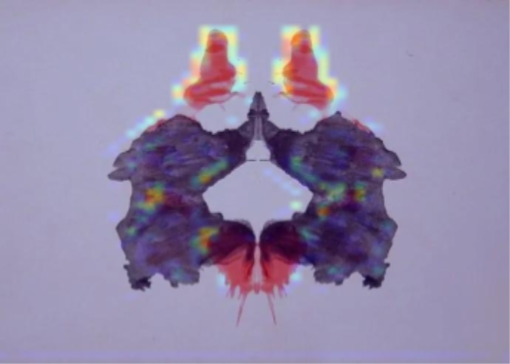
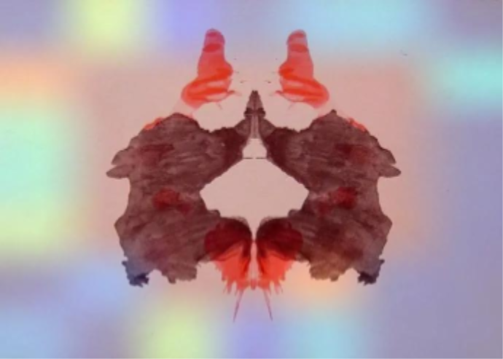
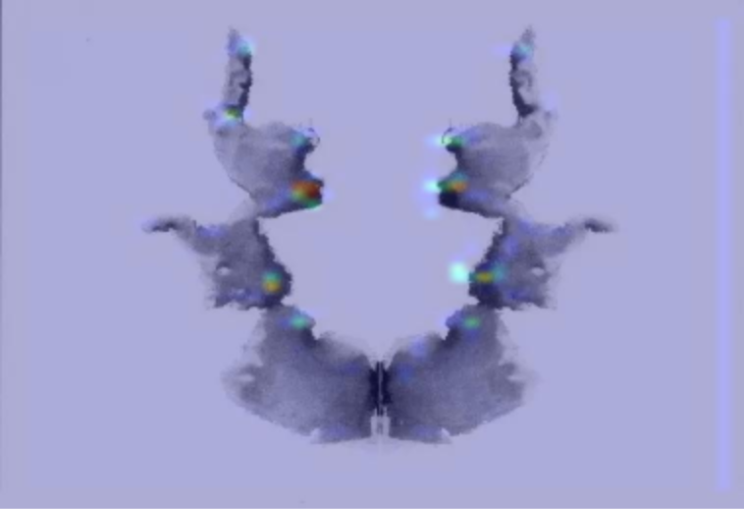
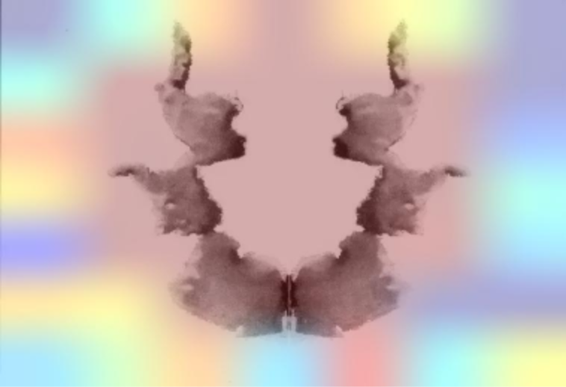
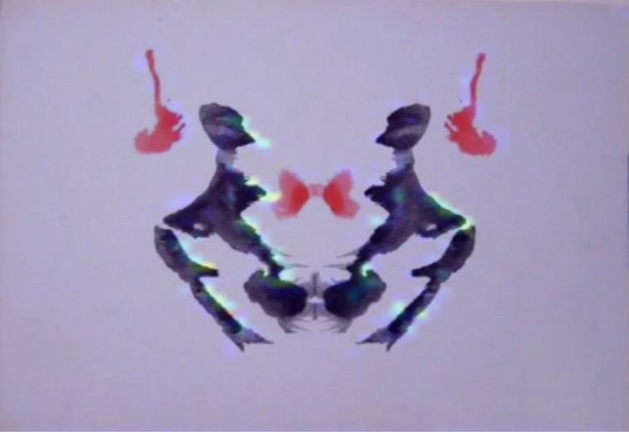
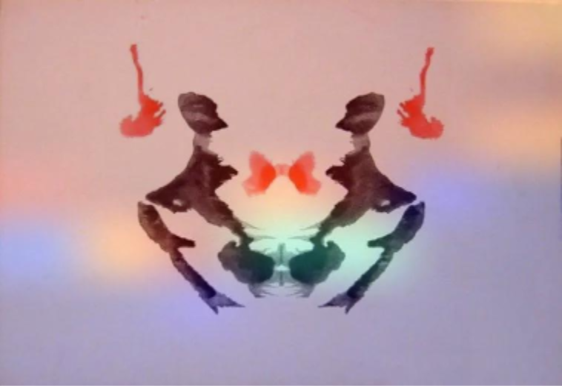
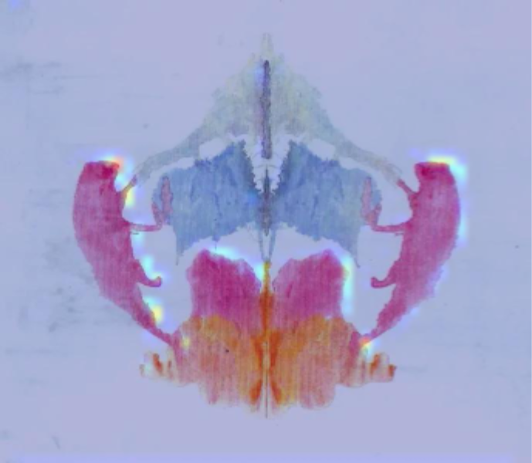
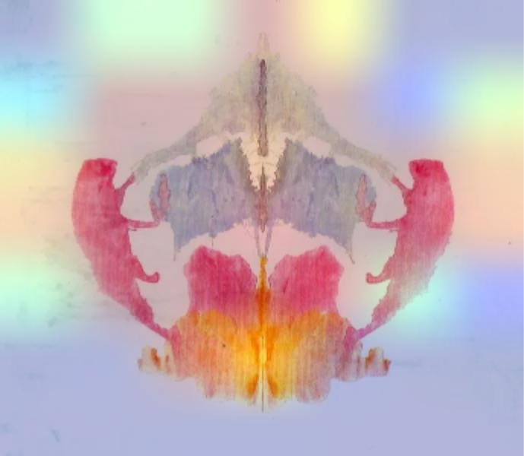
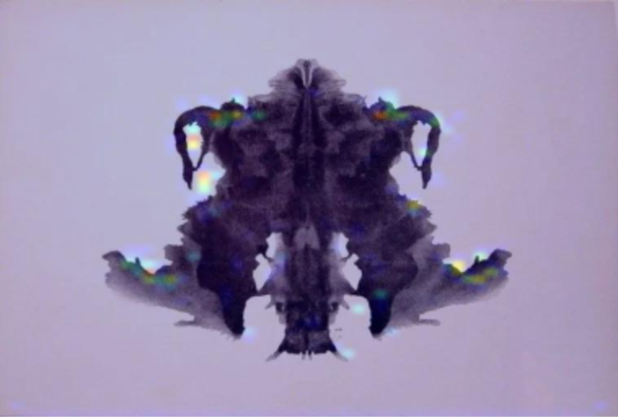
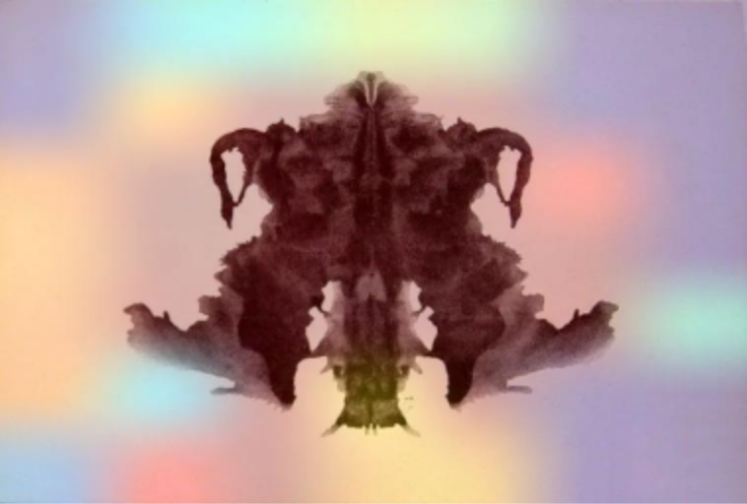
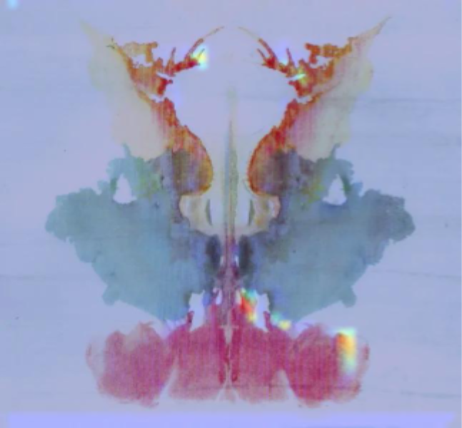
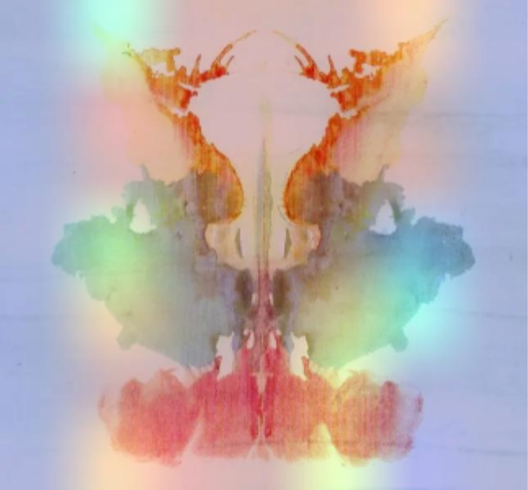
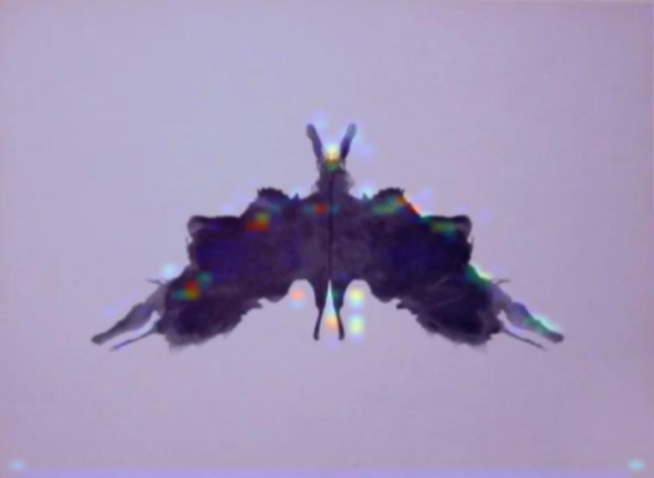
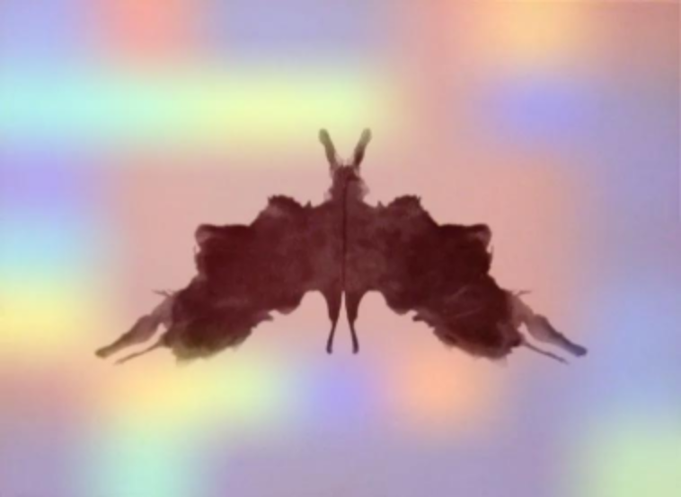
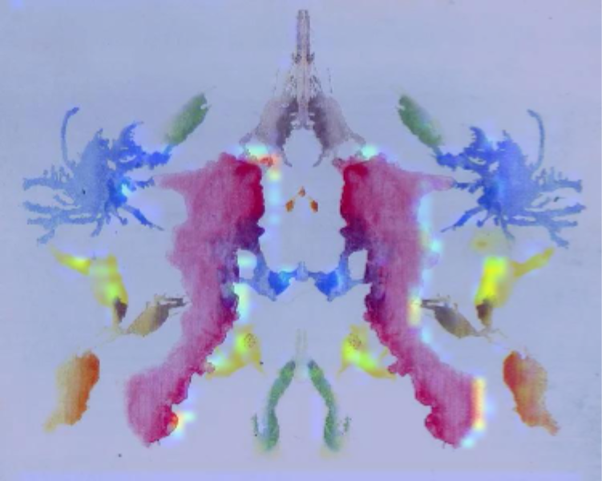
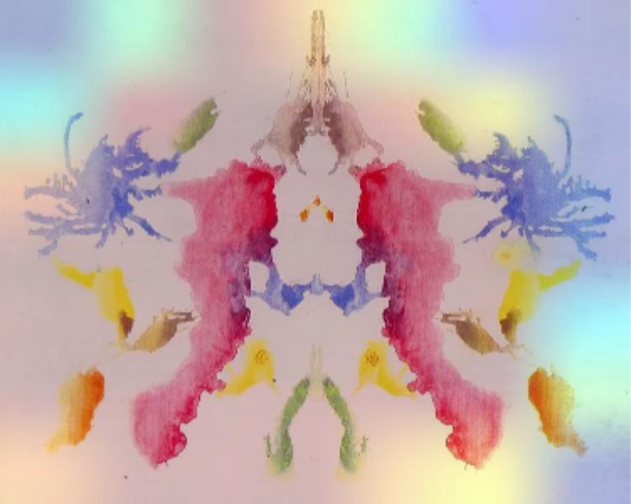
Rorschach | Model A | Model B | Rorschach | Model A | Model B
1 |  |  | 6
2 |  |  | 7
3 |  |  | 8
4 |  |  | 9
5 |  |  | 10

Slide 15






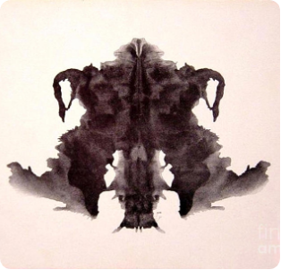

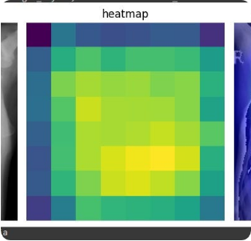
The Visual Difference
Original Stimulus
Naive Perception
Expert Perception
Unfocused, Guessing
Focused, Confident

Slide 16
Card # | Standard Human Perception (Popular Responses) | Model A (Naive) Prediction | Model B (Expert) Prediction
I | Bat, Butterfly, Moth | Dog (55%) | Butterfly (50%)
II | Two Humans, Bear, Elephant | Chicken (99%) | Chicken (93%)
III | Two Humans (Waiters), Bowtie | Butterfly (86%) | Butterfly (29%)
IV | Animal Hide, Monster, Bigfoot | Butterfly (46%) | Spider (56%)
V | Bat, Butterfly | Butterfly (30%) | Spider (93%)
VI | Animal Hide, Rug | Dog (74%) | Cat (44%)
VII | Human Heads, Faces | Dog (27%) | Horse (34%)
VIII | Four-legged animals (Bears/Lions) | Butterfly (86%) | Butterfly (93%)
IX | Human Heads, Fire (Vague card) | Butterfly (68%) | Butterfly (61%)
X | Crab, Lobster, Spider | Butterfly (97%) | Butterfly (89%)

Slide 17
Can AI Experience It?
Short answer: Not really, AI doesn’t experience anything.
But it can behave like pareidolia under the right conditions.
AI does not have subjective perception. It does not “see” or “hallucinate” it processes patterns mathematically.
But neural networks are pattern-matching engines, so when forced to classify ambiguous noise… they project their learned categories onto it, similar to human pareidolia.
Conclusion: AI doesn’t truly experience pareidolia, but it can simulate the behavior because it is driven to map patterns onto categories— even when no real object exists.

Slide 18
Future Improvements
Expand images to humans and objects and more animals
Make an outline of each of the photos in the training model Because the inkblots are made 2D and the training data has much more depth in each image
Making the last 3 inkblots in grayscale as the color could have had an impact on choosing a butterfly.

Slide 19
"Experience is the lens through which we perceive the world."
Conclusion
For an AI to exhibit human-like pattern recognition in ambiguity (Pareidolia), it requires a massive foundation of prior experiential data. The naive mind sees only noise; the experienced mind sees meaning.

Slide 20
Q&A?

